Slide 1
Biomedical Instrumentation
Prosthetic Arm
Group Members:
Susmoy Mukherjee 17BEE0220
Kushagra Goyal 17BEE0173
Danish Safdar 17BEE0067
Ayushman Ranu 17BEE0214
Aditya Das 17BEE0267
Submitted to-
Prof. P. Uma Sathyakam

Slide 2
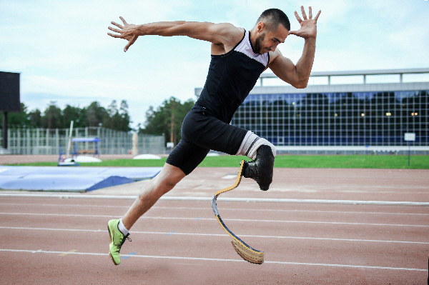
Introduction
Prosthesis is an artificial device that replaces a missing body part, which may be lost through trauma, disease, or congenital conditions.
Its intends to restore the normal functions of the missing part.

Slide 3
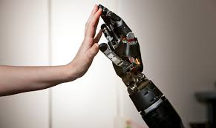
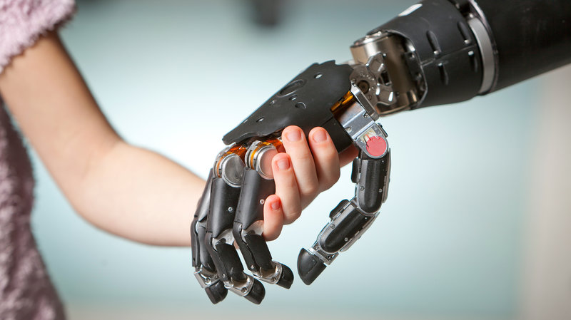
Prosthetic Arm
These are mainly made of lightweight materials for better convenience of the amputee like plastics, light-weight metals(titanium, aluminium), carbon fibres, etc.
We can attach prosthetic arms to the body both permanently and non permanently.
Prosthetic hands are available in both voluntary opening and voluntary closing versions

Slide 4
Working Principle
To understand how a prosthetic arm works we must understand how our muscles work-
The motor cortex in the brain sends out control signals which reach the nerve stubs when these reach the muscles the action potential increases and on increasing beyond a certain threshold value the muscle contracts.
The prosthetic arm made by us works on a similar principle-
We attach an EMG(Electromyogram) which detects the voltage which is connected to an arduino, when the voltage crosses the threshold value, the arduino instructs a servo motor to start rotating which results in the contraction of the arm and hence it starts moving.
When the voltage goes below the threshold value the arm relaxes and hence the motor is stopped.

Slide 5
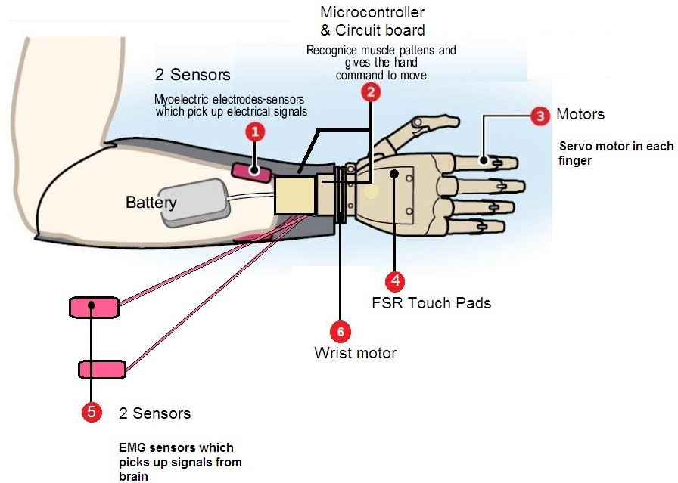
Schematic Diagram

Slide 6
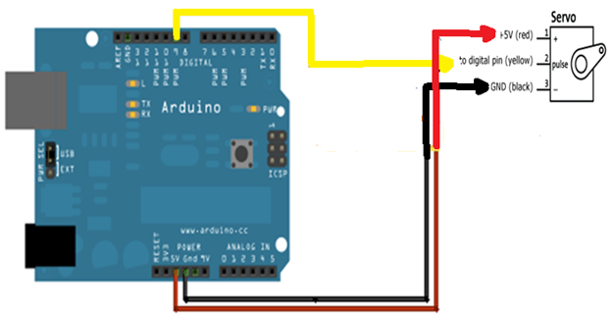
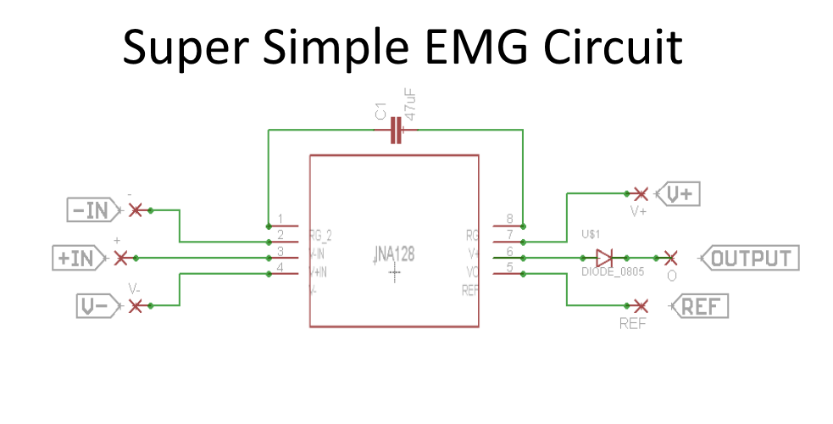
Circuit Diagram

Slide 7
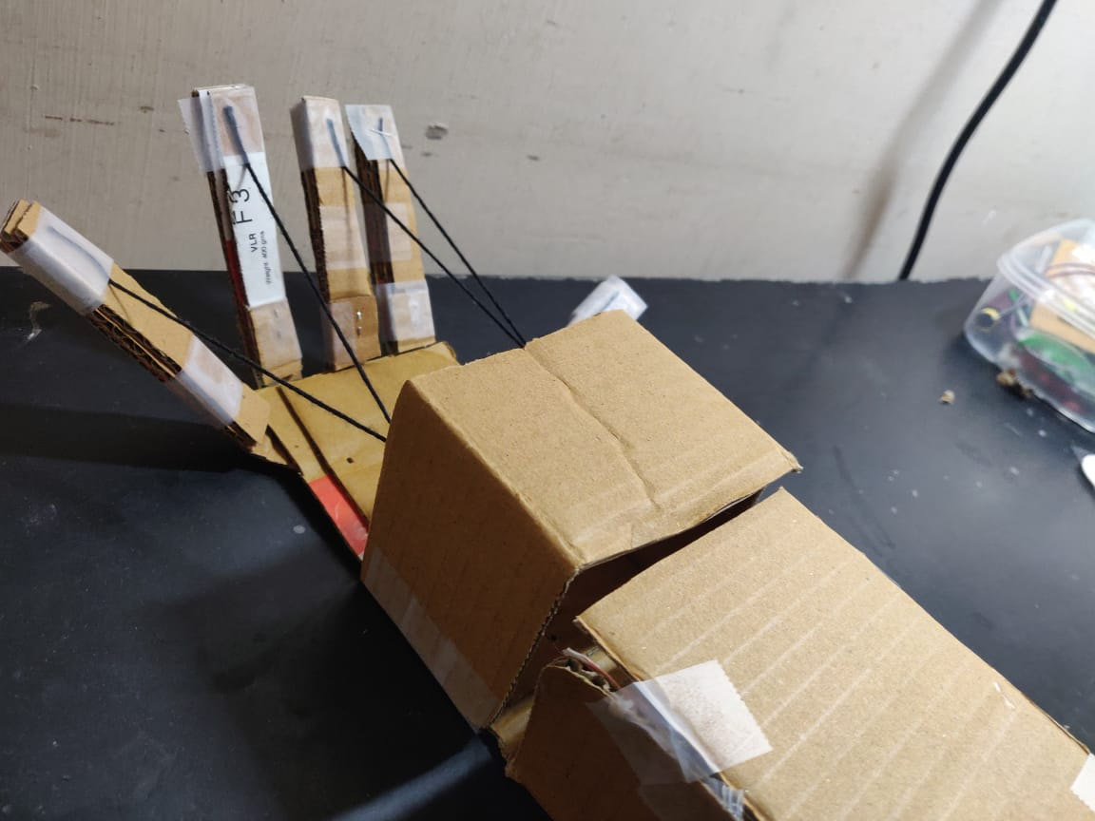
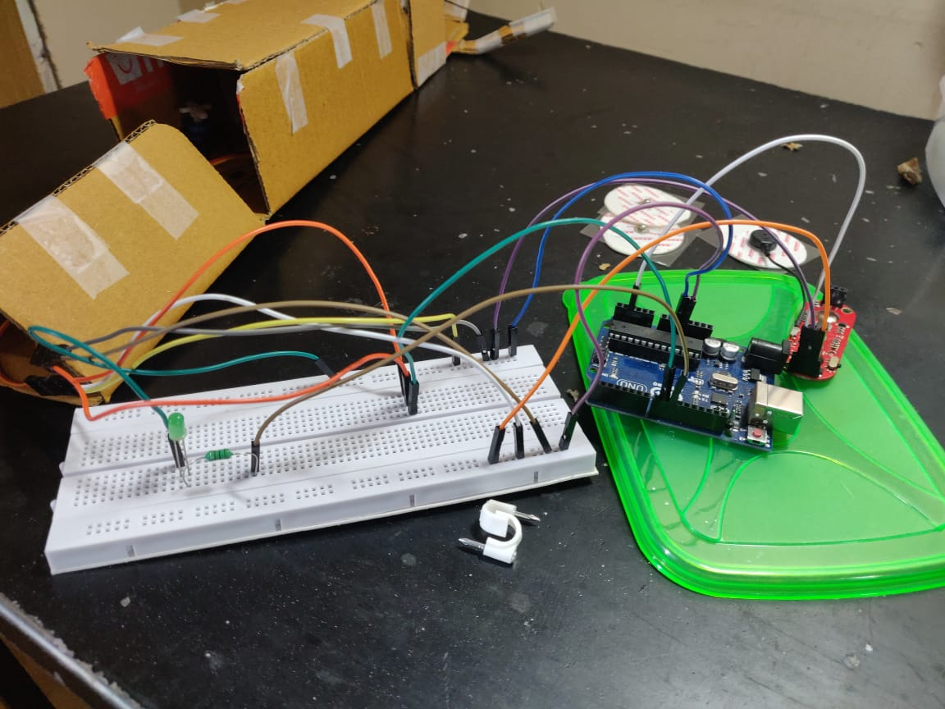
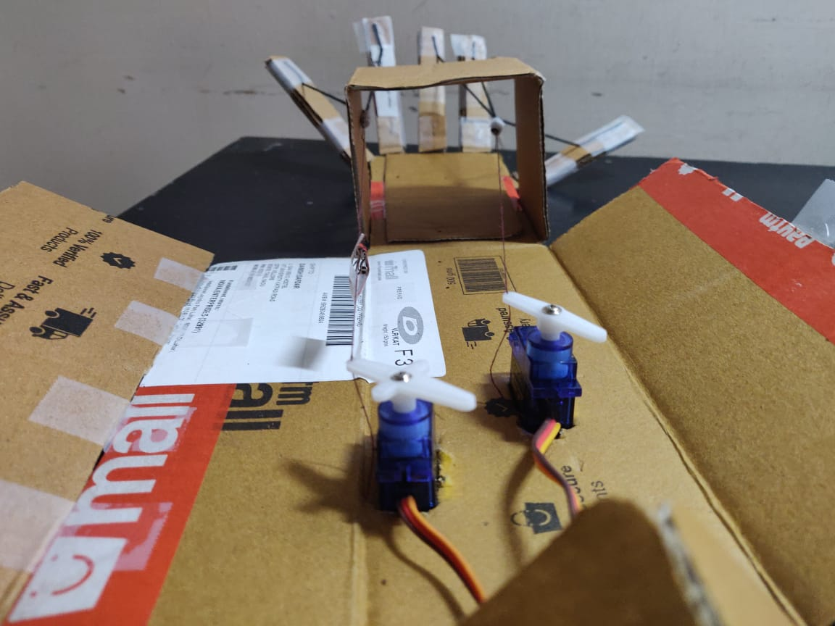
Our Project

Slide 8
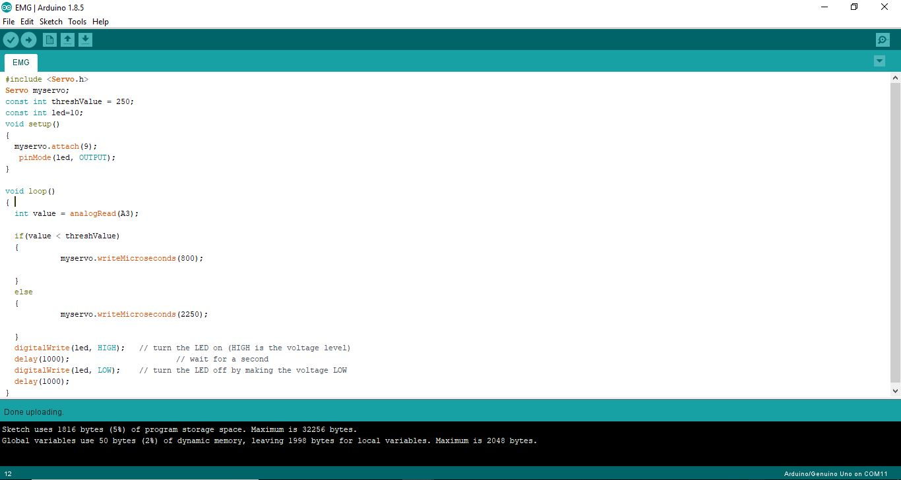
Coding

Slide 9
Applications
Robotic prostheses controlled via implanted neuromuscular interfaces have become a clinical reality. A novel osseointegrated (bone-anchored) implant system gives patients new opportunities in their daily life and professional activities.
In addition to the standard artificial limb for everyday use, many amputees or congenital patients have special limbs and devices to aid in the participation of sports and recreational activities.
Based on this principle robotic arms are made which can be used in industries to lift heavy goods which cannot be lifted by humans easily.

Slide 10
Future Prospects
Prosthetic arms are not a new invention but they are very expensive and cannot be afforded by all.
If given the opportunity, we can make them affordable for all and can also make the arm more effective and more intelligent.
We can also make the prosthetic arms better than actual arms by ensuring it can do not only the tasks which we do with are arms but also lift heavy items and also we can increase the reflexes of these arms.
In our present project we can incorporate more motors to control not only the movement of hands but also arms.
In future we can build a controller which can handle such movements too and also safety equipment in case of trouble situations.

Slide 11


